Slide 1
SQL – DATA DEFINITION AND DATA MANIPULATION (2)
Course : ISYS6280 – Database Systems (GAT)
Year : 2017
Session 7&8

Slide 2
LEARNING OUTCOME
LO 2 : Apply database language and SQL Programming language

Slide 3
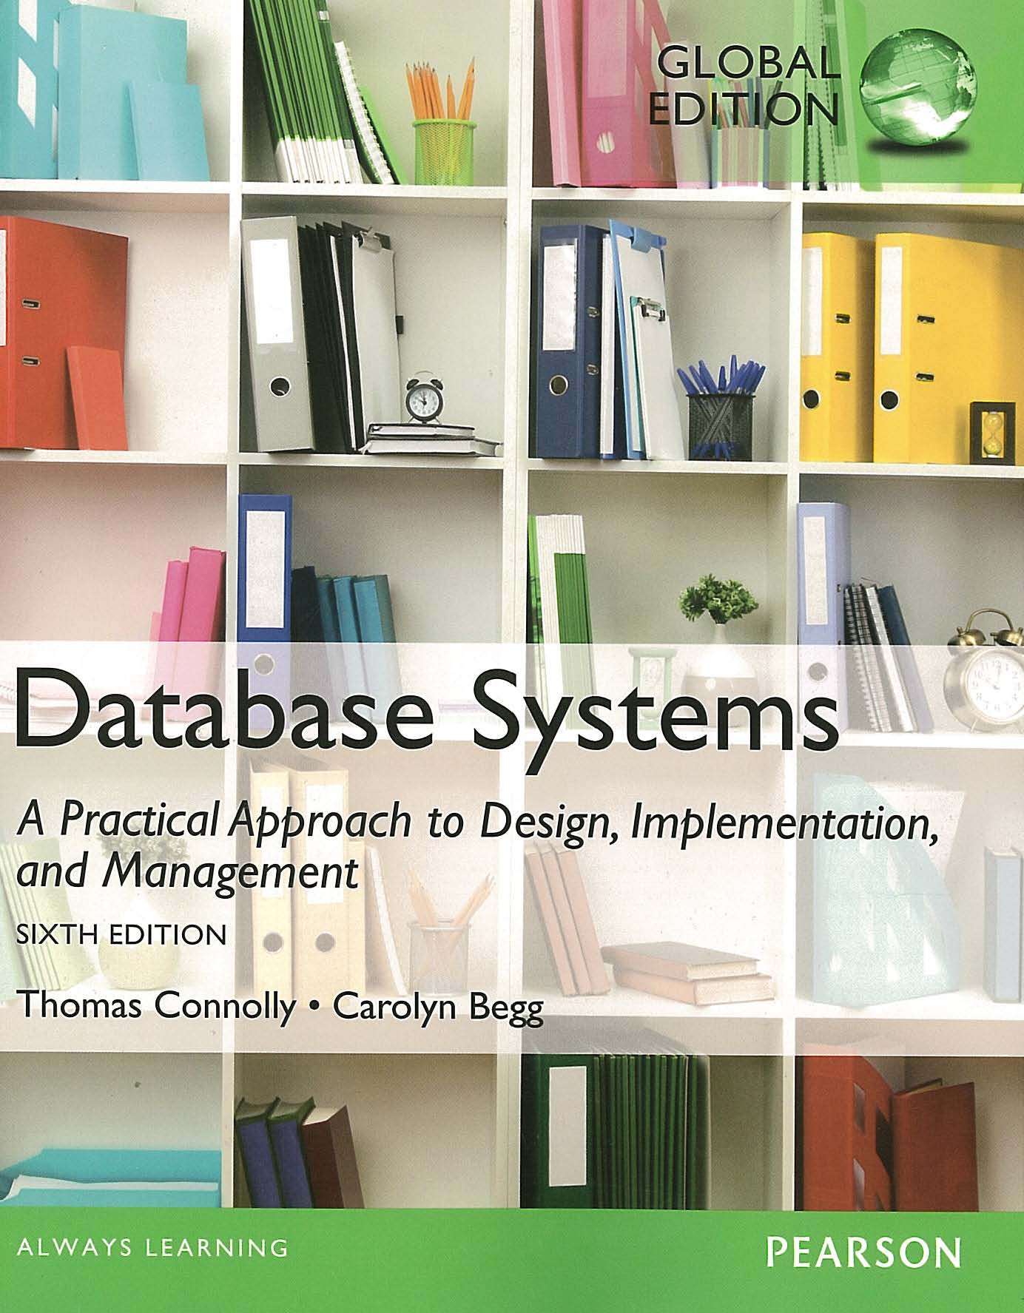
ACKNOWLEDGEMENT
These slides have been adapted from Thomas Connolly and Carolyn Begg. 2015. Database Systems: A Practical Approach To Design, Implementation, and Management. Pearson Education. USA. ISBN:978-1-292-06118-4

Slide 4
CHAPTER 6 SQL : DATA MANIPULATION

Slide 5

LEARNING OBJECTIVES-CHAPTER 6
How to retrieve data from database using SELECT and:
Join tables together.
Use subqueries.
String and Date Functions
Perform set operations (UNION, INTERSECT, EXCEPT).
How to update database using INSERT, UPDATE, and DELETE.
vtraining-msuhandi.blogspot.com

Slide 7
comment

Slide 8
Join Tables

Slide 9
Multi-Table Queries
Can use subqueries provided result columns come from same table.
If result columns come from more than one table must use a join.
To perform join, include more than one table in FROM clause.
Use comma as separator and typically include WHERE clause to specify join column(s).
Also possible to use an alias for a table named in FROM clause.
Alias is separated from table name with a space.
Alias can be used to qualify column names when there is ambiguity.

Slide 10

Example 6.24 Simple Join
List names of all clients who have viewed a property along with any comment supplied.
SELECT c.clientNo, fName, lName,
propertyNo, comment
FROM Client c, Viewing v
WHERE c.clientNo = v.clientNo;
musicbydesign.com

Slide 11
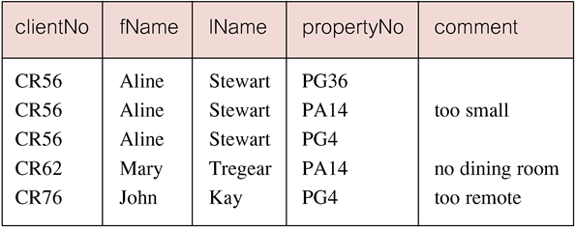
Example 6.24 Simple Join
Only those rows from both tables that have identical values in the clientNo columns (c.clientNo = v.clientNo) are included in result.

Slide 12

Alternative JOIN Constructs
SQL provides alternative ways to specify joins:
FROM Client c JOIN Viewing v ON c.clientNo = v.clientNo
FROM Client JOIN Viewing USING clientNo
FROM Client NATURAL JOIN Viewing
In each case, FROM replaces original FROM and WHERE. However, first produces table with two identical clientNo columns.
www.iscast.org

Slide 13
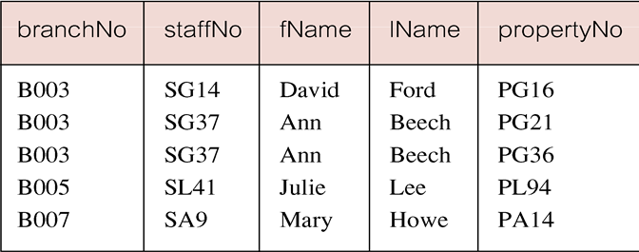
Example 6.25 Sorting a join
For each branch, list numbers and names of staff who manage properties, and properties they manage.
SELECT s.branchNo, s.staffNo, fName, lName,
propertyNo
FROM Staff s, PropertyForRent p
WHERE s.staffNo = p.staffNo
ORDER BY s.branchNo, s.staffNo, propertyNo;

Slide 14
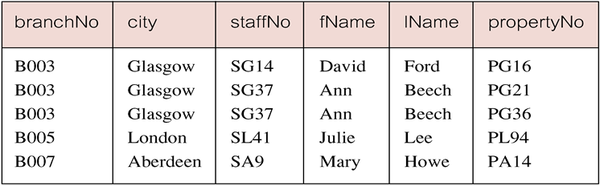
Example 6.26 Three Table Join
For each branch, list staff who manage properties, including city in which branch is located and properties they manage.
SELECT b.branchNo, b.city, s.staffNo, fName, lName,
propertyNo
FROM Branch b, Staff s, PropertyForRent p
WHERE b.branchNo = s.branchNo AND
s.staffNo = p.staffNo
ORDER BY b.branchNo, s.staffNo, propertyNo;
Alternative formulation for FROM and WHERE:
FROM (Branch b JOIN Staff s USING branchNo) AS
bs JOIN PropertyForRent p USING staffNo
Notes:
Revisi Ganjil 17/18

Slide 15
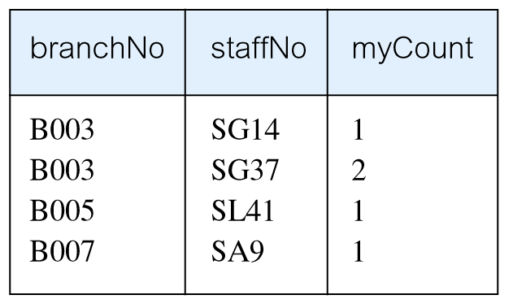
Example 6.27 Multiple Grouping Columns
Find number of properties handled by each staff member.
SELECT s.branchNo, s.staffNo, COUNT(*) AS myCount
FROM Staff s, PropertyForRent p
WHERE s.staffNo = p.staffNo
GROUP BY s.branchNo, s.staffNo
ORDER BY s.branchNo, s.staffNo;

Slide 16
Computing a Join
Procedure for generating results of a join are:
Form Cartesian product of the tables named in FROM clause.
If there is a WHERE clause, apply the search condition to each row of the product table, retaining those rows that satisfy the condition.
3. For each remaining row, determine value of each item in SELECT list to produce a single row in result table.
4. If DISTINCT has been specified, eliminate any duplicate rows from the result table.
5. If there is an ORDER BY clause, sort result table as required.
SQL provides special format of SELECT for Cartesian product:
SELECT [DISTINCT | ALL] {* | columnList}
FROM Table1 CROSS JOIN Table2

Slide 17
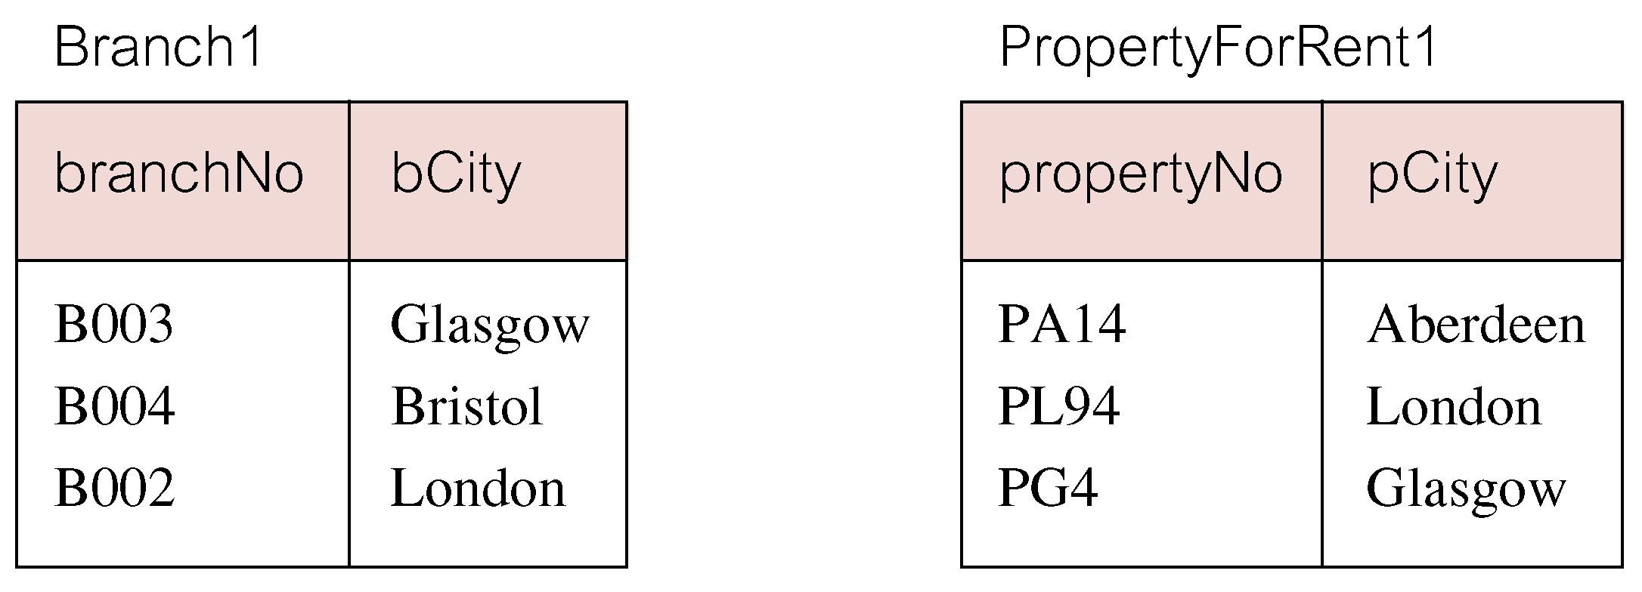
Outer Joins
If one row of a joined table is unmatched, row is omitted from result table.
Outer join operations retain rows that do not satisfy the join condition.
Consider following tables:

Slide 18
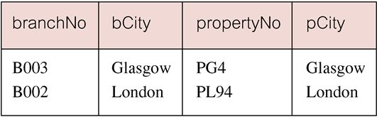
Outer Joins
The (inner) join of these two tables:
SELECT b.*, p.*
FROM Branch1 b, PropertyForRent1 p
WHERE b.bCity = p.pCity;

Slide 19
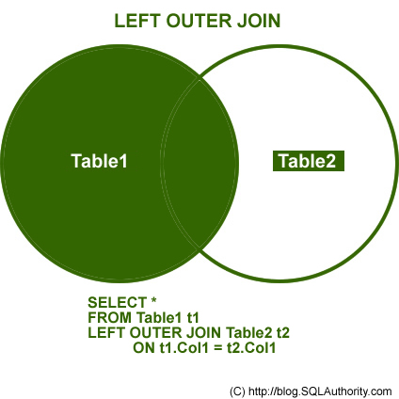
Outer Joins
Result table has two rows where cities are same.
There are no rows corresponding to branches in Bristol and Aberdeen.
To include unmatched rows in result table, use an Outer join.

Slide 20
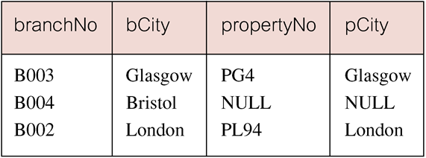
Example 6.28 Left Outer Join
List branches and properties that are in same city along with any unmatched branches.
SELECT b.*, p.*
FROM Branch1 b LEFT JOIN
PropertyForRent1 p ON b.bCity = p.pCity;
Includes those rows of first (left) table unmatched with rows from second (right) table.
Columns from second table are filled with NULLs.

Slide 21
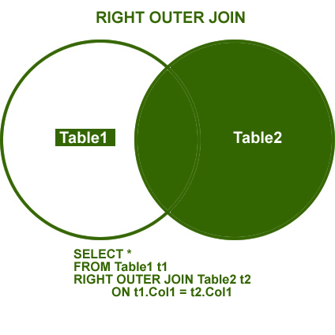
Example 6.29 Right Outer Join
List branches and properties in same city and any unmatched properties.
SELECT b.*, p.*
FROM Branch1 b RIGHT JOIN
PropertyForRent1 p ON b.bCity = p.pCity;
dotnetslackers.com

Slide 22
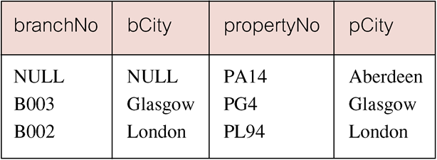
Example 6.29 Right Outer Join
Right Outer join includes those rows of second (right) table that are unmatched with rows from first (left) table.
Columns from first table are filled with NULLs.

Slide 23
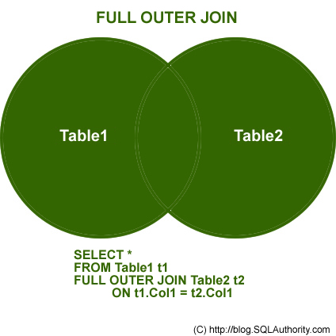
Example 6.30 Full Outer Join
List branches and properties in same city and any unmatched branches or properties.
SELECT b.*, p.*
FROM Branch1 b FULL JOIN
PropertyForRent1 p ON b.bCity = p.pCity;

Slide 24
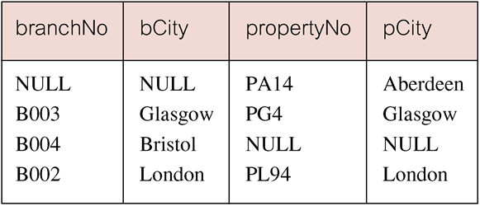
Example 6.30 Full Outer Join
Includes rows that are unmatched in both tables.
Unmatched columns are filled with NULLs.

Slide 25
Subqueries

Slide 26
Subqueries
Some SQL statements can have a SELECT embedded within them.
A subselect can be used in WHERE and HAVING clauses of an outer SELECT, where it is called a subquery or nested query.
Subselects may also appear in INSERT, UPDATE, and DELETE statements.

Slide 27
Example 6.19 Subquery with Equality
List staff who work in branch at ‘163 Main St’.
SELECT staffNo, fName, lName, position
FROM Staff
WHERE branchNo =
(SELECT branchNo
FROM Branch
WHERE street = ‘163 Main St’);

Slide 28
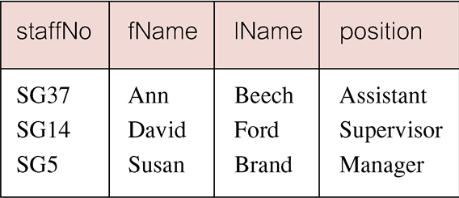
Example 6.19 Subquery with Equality
Inner SELECT finds branch number for branch at ‘163 Main St’ (‘B003’).
Outer SELECT then retrieves details of all staff who work at this branch.
Outer SELECT then becomes:
SELECT staffNo, fName, lName, position
FROM Staff
WHERE branchNo = ‘B003’;

Slide 29
Example 6.20 Subquery with Aggregate
List all staff whose salary is greater than the average salary, and show by how much.
SELECT staffNo, fName, lName, position,
salary – (SELECT AVG(salary) FROM Staff) As SalDiff
FROM Staff
WHERE salary >
(SELECT AVG(salary)
FROM Staff);

Slide 30
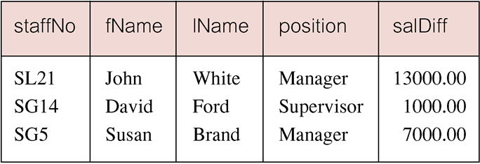
Example 6.20 Subquery with Aggregate
Cannot write ‘WHERE salary > AVG(salary)’
Instead, use subquery to find average salary (17000), and then use outer SELECT to find those staff with salary greater than this:
SELECT staffNo, fName, lName, position,
salary – 17000 As salDiff
FROM Staff
WHERE salary > 17000;

Slide 31
Subquery Rules
ORDER BY clause may not be used in a subquery (although it may be used in outermost SELECT).
Subquery SELECT list must consist of a single column name or expression, except for subqueries that use EXISTS.
By default, column names refer to table name in FROM clause of subquery. Can refer to a table in FROM using an alias.
When subquery is an operand in a comparison, subquery must appear on right-hand side.
A subquery may not be used as an operand in an expression.

Slide 32
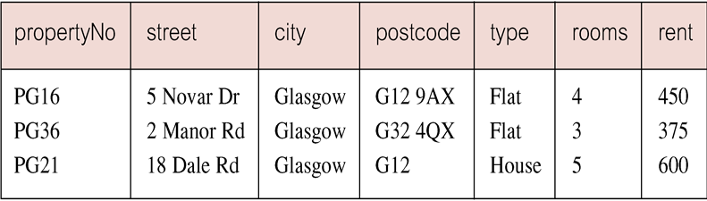
Example 6.21 Nested subquery: use of IN
List properties handled by staff at ‘163 Main St’.
SELECT propertyNo, street, city, postcode, type, rooms, rent
FROM PropertyForRent
WHERE staffNo IN
(SELECT staffNo
FROM Staff
WHERE branchNo =
(SELECT branchNo
FROM Branch
WHERE street = ‘163 Main St’));

Slide 33
ANY and ALL
ANY and ALL may be used with subqueries that produce a single column of numbers.
With ALL, condition will only be true if it is satisfied by all values produced by subquery.
With ANY, condition will be true if it is satisfied by any values produced by subquery.
If subquery is empty, ALL returns true, ANY returns false.
SOME may be used in place of ANY.

Slide 34
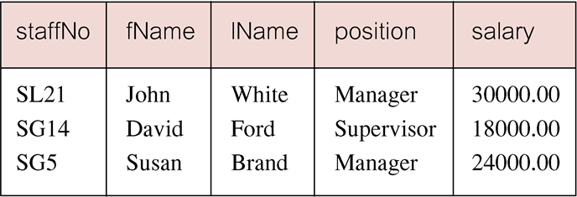
Example 6.22 Use of ANY/SOME
Find staff whose salary is larger than salary of at least one member of staff at branch B003.
SELECT staffNo, fName, lName, position, salary
FROM Staff
WHERE salary > SOME
(SELECT salary
FROM Staff
WHERE branchNo = ‘B003’);
Inner query produces set {12000, 18000, 24000} and outer query selects those staff whose salaries are greater than any of the values in this set.

Slide 35
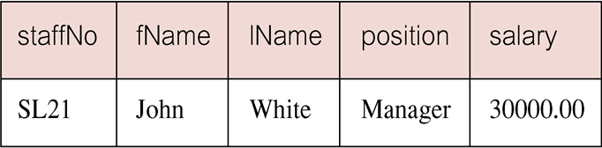
Example 6.23 Use of ALL
Find staff whose salary is larger than salary of every member of staff at branch B003.
SELECT staffNo, fName, lName, position, salary
FROM Staff
WHERE salary > ALL
(SELECT salary
FROM Staff
WHERE branchNo = ‘B003’);
Inner query produces set {12000, 18000, 24000} and outer query selects those staff whose salaries are greater than all of the values in this set.
Notes:
Revisi di Ganjil 17/18

Slide 36
EXISTS and NOT EXISTS
EXISTS and NOT EXISTS are for use only with subqueries.
Produce a simple true/false result.
True if and only if there exists at least one row in result table returned by subquery.
False if subquery returns an empty result table.
NOT EXISTS is the opposite of EXISTS.
As (NOT) EXISTS check only for existence or non-existence of rows in subquery result table, subquery can contain any number of columns.
Common for subqueries following (NOT) EXISTS to be of form:
(SELECT * ...)

Slide 37
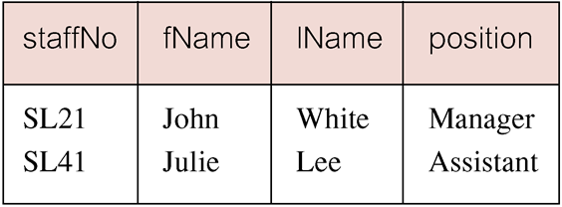
Example 6.31 Query using EXISTS
Find all staff who work in a London branch.
SELECT staffNo, fName, lName, position
FROM Staff s
WHERE EXISTS
(SELECT *
FROM Branch b
WHERE s.branchNo = b.branchNo AND
city = ‘London’);

Slide 38
Example 6.31 Query using EXISTS
Note, search condition s.branchNo = b.branchNo is necessary to consider correct branch record for each member of staff.
If omitted, would get all staff records listed out because subquery:
SELECT * FROM Branch WHERE city=‘London’
would always be true and query would be:
SELECT staffNo, fName, lName, position FROM Staff
WHERE true;
Could also write this query using join construct:
SELECT staffNo, fName, lName, position
FROM Staff s, Branch b
WHERE s.branchNo = b.branchNo AND
city = ‘London’;

Slide 39
Functions

Slide 40
Character/ String Functions
SQL string function is a built-in string function.
It perform an operation on a string input value and return a string or numeric value.
Below is All built-in Sql string function :
RIGHT, LEFT, SUBSTRING, CHARINDEX, STUFF, REPLACE,CAST,CONVERT, LTRIM, RTRIM,LOWER,UPPER,LEN, REVERSE

Slide 41
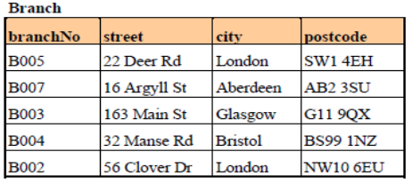
RIGHT
Returns right part of a string with the specified number of characters.
Format:
RIGHT( field_name, length)
Example: how to returns three last digits of postcode in Branch table
SELECT RIGHT(postcode,3) FROM Branch
Result:
4EH
3SU
9QX
1NZ
6EU
Notes:
Revisi Ganjil 17/18

Slide 42
LEFT
Returns left part of a string with the specified number of characters.
Format :
LEFT ( field_name, length)
Example: how to returns three first digits of postcode in Branch table
SELECT LEFT(postcode,3) FROM Branch
Result:
SW1
AB2
G11
BS9
NW1
Notes:
Revisi Ganjil 17/18

Slide 43
SUBSTRING
Returns part of a string.
Format :
SUBSTRING ( Field_name, startindex , length )
Example: how to returns postcode in Branch table, started from second character and the length is 4
SELECT SUBSTRING(postcode,2,4) FROM Branch
Result:
W1 4
B2 3
11 9
S99
W10
Notes:
Revisi Ganjil 17/18

Slide 44
CHARINDEX
Returns the starting position of a character string.
Format :
CHARINDEX ( searched_string, field_name [ , start_location ] )
Example: how to show ‘1’ character position of postcode in Branch table
SELECT CHARINDEX(‘1’,postcode,0) FROM Branch
Result:
3
0
2
6
3
Notes:
Revisi Ganjil 17/18

Slide 45
STUFF
Deletes a specified length of characters and inserts string at a specified starting index.
Format :
STUFF ( character_expression , startindex , length , replaceWith_expression )
Example: how to modify ‘B’ character of branchNo in Branch table become ‘BR’
SELECT STUFF(branchNo,1,1,’BR’) FROM Branch
Result:
BR005
BR007
BR003
BR004
BR002
Notes:
Revisi Ganjil 17/18

Slide 46
REPLACE
Replaces all occurrences of the string2 in the string1 with string3
Format :
REPLACE ( 'string1' , 'string2' , 'string3' )
Example: how to replace ‘St’ character of street in Branch table become ‘Street’
SELECT REPLACE(street,’St’,’Street’) FROM Branch
Result:
22 Deer Rd
16 Argyll Street
163 Main Street
32 Manse Rd
56 Clover Dr
Notes:
Revisi Ganjil 17/18

Slide 47
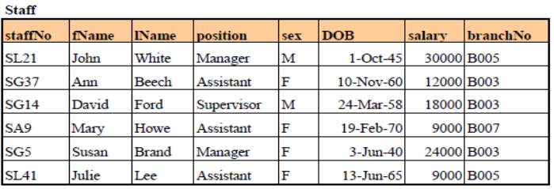
CAST & CONVERT
It converts an expression from one data type to another.
Format :
CAST ( expression AS data_type )
CONVERT ( data_type [ ( length ) ] , expression [ , style ] )
Example :
CAST
SELECT ‘$’ + CAST (salary as varchar)
FROM Staff Where staffNo=SA9
Result : $ 9000
Change TransactionDate
SELECT CONVERT (varchar,DOB,106)
FROM Staff Where staffNo=SL21
Result : 1 October 1945
Notes:
Revisi Ganjil 17/18

Slide 48
LTRIM / RTRIM
Returns a string after removing leading blanks on Left side (LTRIM) and Right side (RTRIM).
Format :
LTRIM( string )
RTRIM( string )
Example
LTRIM (‘ Yunita Angelina’)
Result : ‘Yunita Angelina’
RTRIM (‘Yunita Angelina ’)
Result : ‘Yunita Angelina’

Slide 49
LOWER
Convert string to lowercase.
Format :
LOWER( string )
Example :
SELECT LOWER (fName)
FROM Staff WHERE staffNo=SG37
Result : ann
Notes:
Revisi Ganjil 17/18

Slide 50
UPPER
Convert string to Uppercase.
Format :
UPPER( string )
Example :
SELECT UPPER (fName)
FROM Staff WHERE staffNo=SG37
Result : ANN
Notes:
Revisi Ganjil 17/18

Slide 51
LEN
Returns number of characters in a string.
Format :
LEN( string)
Example :
SELECT LEN(fName)
FROM Staff WHERE staffNo=SG37
Result : 3
Notes:
Revisi Ganjil 17/18

Slide 52
REVERSE
Returns reverse a string.
Format :
REVERSE( string)
Example :
SELECT REVERSE (fName)
FROM Staff WHERE staffNo=SG37
Result : nnA
Notes:
Revisi Ganjil 17/18

Slide 53
Date Functions
DAY(date)
MONTH (date)
DATENAME (<datepart>, date)
YEAR (date)
DATEPART (<datepart>, date)
DATEDIFF( <datepart>, <startdate>, <enddate> )
DATEADD (<datepart>,<number>,<date.)
To start the used of DATE functions, we can use statement Select GETDATE (), then systems will display the date and time when we execute the query as follows :
2016-11-21 09:59:12.967

Slide 54

DAY and DATENAME
DAY function is used to take out only the Date data from one set of Date. Commonly in database systems, the Date format are YYYY-MM-DD, MM-DD-YYYY, DD-MM-YYYY
Example :
Display only the Date from TransactionDate 21 Nov 2016
Select DAY (’11/21/2016’)
Result : 21
All Data from table : DAY (TransactionDate)
If you want to display the name of the day, you can use DATENAME function as follows :
DATENAME (WEEKDAY, TransactionDate)
Select DATENAME (WEEKDAY, ’11/21/2016')
Result : Monday
OntarioColleges.ca

Slide 55

MONTH and DATENAME
MONTH function is used to take out only the Month data from one set of Date. Commonly in database systems, the Date format are YYYY-MM-DD, MM-DD-YYYY, DD-MM-YYYY
Example :
Display only the Month from TransactionDate 22 Nov 2016
Select MONTH (’11/22/2016’)
Result : 11
All Data from table : MONTH (TransactionDate)
If you want to display the name of the month, you can use DATENAME function as follows :
DATENAME (MONTH, TransactionDate)
Select DATENAME (MONTH,‘11/22/2016')
Result : November
https://blog.threattrack.com/end-of-month-security-recap-for-july-2013/

Slide 56

YEAR
YEAR function is used to take out only the Year data from one set of Date. Commonly in database systems, the Date format are YYYY-MM-DD, MM-DD-YYYY, DD-MM-YYYY
Example :
Display only the Year from TransactionDate 22 July 2016
Select YEAR (’11/21/2016’)
Result : 2016
All Data from table (one column) : YEAR (‘TransactionDate’)
http://combiboilersleeds.com/keywords/year-1.html

Slide 57
DATEPART
DATEPART function returns a specified part of a give date, as an integer value
Example :
Select DATEPART (DAY, ‘11/25/2016’)
Result : 25
Select DATEPART (Second, ‘11/25/2016 09:50:32’) or
Select DATEPART (Second, ‘09:50:32’)
Result : 32
Select DATEPART (Minute, ‘11/25/2016 09:50:32’)
Result : 50

Slide 58
DATEDIFF
DATEDIFF function returns the count of the specified datepart boundaries crossed between the specified startdate and enddate
Example :
Display the range TransactionDate between 11/21/2016 and 11/25/2016
Select DATEDIFF (DAY, ’ 11/21/2016’,’ 11/25/2016’)
Result : 4 (means 4 days → 21 to 25)
All data from table : DATEDIFF (DAY,’ TransactionDate’, ’11/25/2016’)

Slide 59
DATEADD
DATEADD function returns the DateTime, after adding specified number to the datepart specified of the given date)
Example :
Select DATEADD (DAY, 5, ‘11/25/2016 09:50:32’)
Result : 2016-11-30 09:50:32.000
Select DATEADD (DAY, -5, ‘11/25/2016 09:50:32’)
Result : 2016-11-20 09:50:32.000

Slide 60
Set Operations (UNION, INTERSECT, EXCEPT)

Slide 61
Union, Intersect, and Difference (Except)
Can use normal set operations of Union, Intersection, and Difference to combine results of two or more queries into a single result table.
Union of two tables, A and B, is table containing all rows in either A or B or both.
Intersection is table containing all rows common to both A and B.
Difference is table containing all rows in A but not in B.
Two tables must be union compatible.

Slide 62
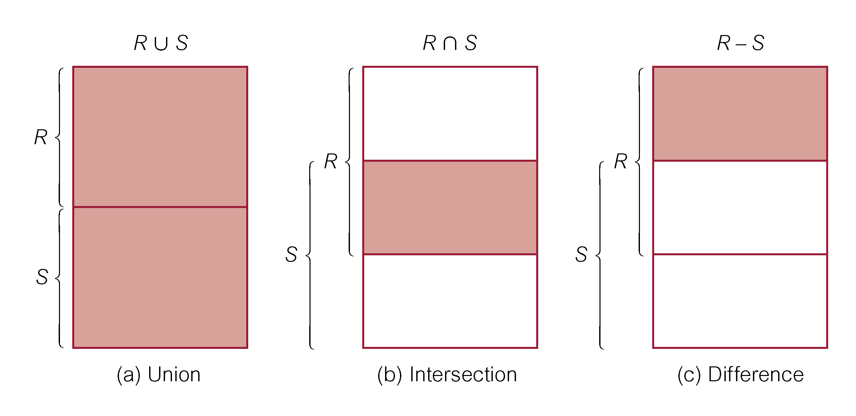
Union, Intersect, and Difference (Except)
Format of set operator clause in each case is:
op [ALL] [CORRESPONDING [BY {column1 [, ...]}]]
If CORRESPONDING BY specified, set operation performed on the named column(s).
If CORRESPONDING specified but not BY clause, operation performed on common columns.
If ALL specified, result can include duplicate rows.

Slide 63
Example 6.32 Use of UNION
List all cities where there is either a branch office or a property.
(SELECT city
FROM Branch
WHERE city IS NOT NULL)
UNION
(SELECT city
FROM PropertyForRent
WHERE city IS NOT NULL);

Slide 64
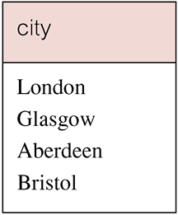
Example 6.32 Use of UNION
Or
(SELECT * FROM Branch WHERE city IS NOT NULL) UNION CORRESPONDING BY city (SELECT * FROM PropertyForRent WHERE city IS NOT NULL);
Produces result tables from both queries and merges both tables together.

Slide 65
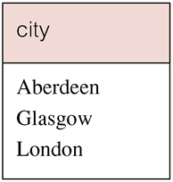
Example 6.33 Use of INTERSECT
List all cities where there is both a branch office and a property.
(SELECT city FROM Branch)
INTERSECT
(SELECT city FROM PropertyForRent);

Slide 66
Example 6.33 Use of INTERSECT
Could rewrite this query without INTERSECT operator:
SELECT b.city
FROM Branch b PropertyForRent p
WHERE b.city = p.city;
Or:
SELECT DISTINCT city FROM Branch b
WHERE EXISTS
(SELECT * FROM PropertyForRent p
WHERE p.city = b.city);

Slide 67
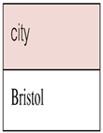
Example 6.34 Use of EXCEPT
List of all cities where there is a branch office but no properties.
(SELECT city FROM Branch)
EXCEPT
(SELECT city FROM PropertyForRent);
Or
(SELECT * FROM Branch)
EXCEPT CORRESPONDING BY city
(SELECT * FROM PropertyForRent);

Slide 68
Example 6.34 Use of EXCEPT
Could rewrite this query without EXCEPT:
SELECT DISTINCT city FROM Branch
WHERE city NOT IN
(SELECT city FROM PropertyForRent);
Or
SELECT DISTINCT city FROM Branch b
WHERE NOT EXISTS
(SELECT * FROM PropertyForRent p
WHERE p.city = b.city);

Slide 69
Simple SQL command (INSERT, UPDATE, DELETE, SELECT)

Slide 70
INSERT
INSERT INTO TableName [ (columnList) ]
VALUES (dataValueList)
columnList is optional; if omitted, SQL assumes a list of all columns in their original CREATE TABLE order.
Any columns omitted must have been declared as NULL when table was created, unless DEFAULT was specified when creating column.
dataValueList must match columnList as follows:
number of items in each list must be same;
must be direct correspondence in position of items in two lists;
data type of each item in dataValueList must be compatible with data type of corresponding column.

Slide 71
Example 6.35 INSERT … VALUES
Insert a new row into Staff table supplying data for all columns.
INSERT INTO Staff
VALUES (‘SG16’, ‘Alan’, ‘Brown’, ‘Assistant’, ‘M’, Date‘1957-05-25’, 8300, ‘B003’);

Slide 72
Example 6.36 INSERT using Defaults
Insert a new row into Staff table supplying data for all mandatory columns.
INSERT INTO Staff (staffNo, fName, lName,
position, salary, branchNo)
VALUES (‘SG44’, ‘Anne’, ‘Jones’,
‘Assistant’, 8100, ‘B003’);
Or
INSERT INTO Staff
VALUES (‘SG44’, ‘Anne’, ‘Jones’, ‘Assistant’, NULL,
NULL, 8100, ‘B003’);

Slide 73
INSERT … SELECT
Second form of INSERT allows multiple rows to be copied from one or more tables to another:
INSERT INTO TableName [ (columnList) ]
SELECT ...

Slide 74
Example 6.37 INSERT … SELECT
Assume there is a table StaffPropCount that contains names of staff and number of properties they manage:
StaffPropCount(staffNo, fName, lName, propCnt)
Populate StaffPropCount using Staff and PropertyForRent tables.

Slide 75
Example 6.37 INSERT … SELECT
INSERT INTO StaffPropCount
(SELECT s.staffNo, fName, lName, COUNT(*)
FROM Staff s, PropertyForRent p
WHERE s.staffNo = p.staffNo
GROUP BY s.staffNo, fName, lName)
UNION
(SELECT staffNo, fName, lName, 0
FROM Staff
WHERE staffNo NOT IN
(SELECT DISTINCT staffNo
FROM PropertyForRent));

Slide 76
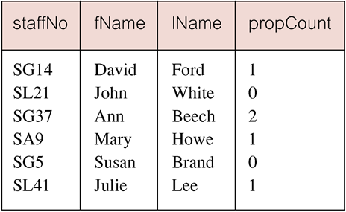
Example 6.37 INSERT … SELECT
If second part of UNION is omitted, excludes those staff who currently do not manage any properties.

Slide 77
UPDATE
UPDATE TableName
SET columnName1 = dataValue1
[, columnName2 = dataValue2...]
[WHERE searchCondition]
TableName can be name of a base table or an updatable view.
SET clause specifies names of one or more columns that are to be updated.
WHERE clause is optional:
if omitted, named columns are updated for all rows in table;
if specified, only those rows that satisfy searchCondition are updated.
New dataValue(s) must be compatible with data type for corresponding column.

Slide 78
Example 6.38/39 UPDATE All Rows
Give all staff a 3% pay increase.
UPDATE Staff
SET salary = salary*1.03;
Give all Managers a 5% pay increase.
UPDATE Staff
SET salary = salary*1.05
WHERE position = ‘Manager’;

Slide 79
Example 6.40 UPDATE Multiple Columns
Promote David Ford (staffNo=‘SG14’) to Manager and change his salary to £18,000.
UPDATE Staff
SET position = ‘Manager’, salary = 18000
WHERE staffNo = ‘SG14’;
SET: new values
WHERE: conditions or old values

Slide 80
DELETE
DELETE FROM TableName
[WHERE searchCondition]
TableName can be name of a base table or an updatable view.
searchCondition is optional; if omitted, all rows are deleted from table. This does not delete table. If search_condition is specified, only those rows that satisfy condition are deleted.

Slide 81
Example 6.41/42 DELETE Specific Rows
Delete all viewings that relate to property PG4.
DELETE FROM Viewing
WHERE propertyNo = ‘PG4’;
Delete all records from the Viewing table.
DELETE FROM Viewing;

Slide 82
BEGIN TRANS
Begin trans use to begin new transaction in query language. Begin trans usually followed by Rollback to cancels any changes made during the current transaction and ends the transaction. It may also start a new transaction
This is the example of use Begin Trans :
begin trans
UPDATE Staff
SET salary = salary*1.05
WHERE position = ‘Manager’
Select * from Staff
Rollback

Slide 83
CHAPTER 7 SQL : DATA DEFINITION

Slide 84
LEARNING OBJECTIVES-CHAPTER 7
Purpose of views.
How to create and delete views using SQL.
How the DBMS performs operations on views.
Under what conditions views are updatable.
Advantages and disadvantages of views.
vtraining-msuhandi.blogspot.com

Slide 85
Views
View
Dynamic result of one or more relational operations operating on base relations to produce another relation.
Virtual relation that does not necessarily actually exist in the database but is produced upon request, at time of request.
Contents of a view are defined as a query on one or more base relations.
With view resolution, any operations on view are automatically translated into operations on relations from which it is derived.
With view materialization, the view is stored as a temporary table, which is maintained as the underlying base tables are updated.

Slide 86
SQL - CREATE VIEW
CREATE VIEW ViewName [ (newColumnName [,...]) ]
AS subselect
[WITH [CASCADED | LOCAL] CHECK OPTION]
Can assign a name to each column in view.
If list of column names is specified, it must have same number of items as number of columns produced by subselect.
If omitted, each column takes name of corresponding column in subselect.

Slide 87
SQL - CREATE VIEW
List must be specified if there is any ambiguity in a column name.
The subselect is known as the defining query.
WITH CHECK OPTION ensures that if a row fails to satisfy WHERE clause of defining query, it is not added to underlying base table.
Need SELECT privilege on all tables referenced in subselect and USAGE privilege on any domains used in referenced columns.

Slide 88
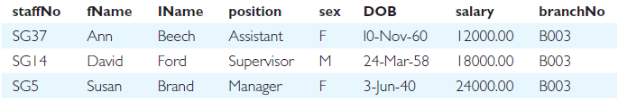
Example 7.3 - Create Horizontal View
Create view so that manager at branch B003 can only see details for staff who work in his or her office.
CREATE VIEW Manager3Staff
AS SELECT *
FROM Staff
WHERE branchNo = ‘B003’;

Slide 89
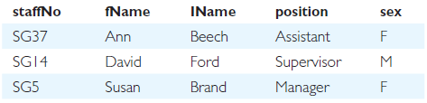
Example 7.4 - Create Vertical View
Create view of staff details at branch B003 excluding salaries.
CREATE VIEW Staff3
AS SELECT staffNo, fName, lName, position, sex
FROM Staff
WHERE branchNo = ‘B003’;

Slide 90
Example 7.5 - Grouped and Joined Views
Create view of staff who manage properties for rent, including branch number they work at, staff number, and number of properties they manage.
CREATE VIEW StaffPropCnt (branchNo, staffNo, cnt)
AS SELECT s.branchNo, s.staffNo, COUNT(*)
FROM Staff s, PropertyForRent p
WHERE s.staffNo = p.staffNo
GROUP BY s.branchNo, s.staffNo;

Slide 91
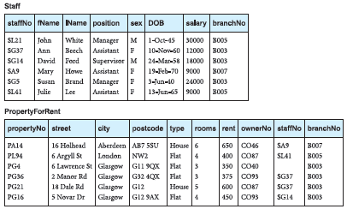
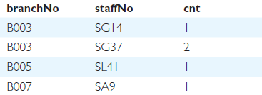
Example 7.5 - Grouped and Joined Views

Slide 92
SQL - DROP VIEW
DROP VIEW ViewName [RESTRICT | CASCADE]
Causes definition of view to be deleted from database.
For example:
DROP VIEW Manager3Staff;
With CASCADE, all related dependent objects are deleted; i.e. any views defined on view being dropped.
With RESTRICT (default), if any other objects depend for their existence on continued existence of view being dropped, command is rejected.

Slide 93
View Resolution
Count number of properties managed by each member at branch B003.
SELECT staffNo, cnt
FROM StaffPropCnt
WHERE branchNo = ‘B003’
ORDER BY staffNo;

Slide 94
View Resolution
(a) View column names in SELECT list are translated into their corresponding column names in the defining query:
SELECT s.staffNo As staffNo, COUNT(*) As cnt
(b) View names in FROM are replaced with corresponding FROM lists of defining query:
FROM Staff s, PropertyForRent p
(c) WHERE from user query is combined with WHERE of defining query using AND:
WHERE s.staffNo = p.staffNo AND branchNo = ‘B003’
(d) GROUP BY and HAVING clauses copied from defining query:
GROUP BY s.branchNo, s.staffNo
(e) ORDER BY copied from query with view column name translated into defining query column name
ORDER BY s.staffNo

Slide 95
View Resolution
(f) Final merged query is now executed to produce the result:
SELECT s.staffNo AS staffNo, COUNT(*) AS cnt
FROM Staff s, PropertyForRent p
WHERE s.staffNo = p.staffNo AND
branchNo = ‘B003’
GROUP BY s.branchNo, s.staffNo
ORDER BY s.staffNo;

Slide 96
Restrictions on Views
SQL imposes several restrictions on creation and use of views.
(a) If column in view is based on an aggregate function:
Column may appear only in SELECT and ORDER BY clauses of queries that access view.
Column may not be used in WHERE nor be an argument to an aggregate function in any query based on view.

Slide 97
Restrictions on Views
For example, following query would fail:
SELECT COUNT(cnt)
FROM StaffPropCnt;
Similarly, following query would also fail:
SELECT *
FROM StaffPropCnt
WHERE cnt > 2;

Slide 98
Restrictions on Views
(b) Grouped view may never be joined with a base table or a view.
For example, StaffPropCnt view is a grouped view, so any attempt to join this view with another table or view fails.

Slide 99
View Updatability
All updates to base table reflected in all views that encompass base table.
Similarly, may expect that if view is updated then base table(s) will reflect change.
However, consider again view StaffPropCnt.
If we tried to insert record showing that at branch B003, SG5 manages 2 properties:
INSERT INTO StaffPropCnt
VALUES (‘B003’, ‘SG5’, 2);
Have to insert 2 records into PropertyForRent showing which properties SG5 manages. However, do not know which properties they are; i.e. do not know primary keys!

Slide 100
View Updatability
If change definition of view and replace count with actual property numbers:
CREATE VIEW StaffPropList (branchNo,
staffNo, propertyNo)
AS SELECT s.branchNo, s.staffNo, p.propertyNo
FROM Staff s, PropertyForRent p
WHERE s.staffNo = p.staffNo;

Slide 101
View Updatability
Now try to insert the record:
INSERT INTO StaffPropList
VALUES (‘B003’, ‘SG5’, ‘PG19’);
Still problem, because in PropertyForRent all columns except postcode/staffNo are not allowed nulls.
However, have no way of giving remaining non-null columns values.

Slide 102
View Updatability
ISO specifies that a view is updatable if and only if:
- DISTINCT is not specified.
- Every element in SELECT list of defining query is a column name and no column appears more than once.
- FROM clause specifies only one table, excluding any views based on a join, union, intersection or difference.
- No nested SELECT referencing outer table.
- No GROUP BY or HAVING clause.
- Also, every row added through view must not violate integrity constraints of base table.

Slide 103
Updatable View
For view to be updatable, DBMS must be able to trace any row or column back to its row or column in the source table.

Slide 104
WITH CHECK OPTION
Rows exist in a view because they satisfy WHERE condition of defining query.
If a row changes and no longer satisfies condition, it disappears from the view.
New rows appear within view when insert/update on view cause them to satisfy WHERE condition.
Rows that enter or leave a view are called migrating rows.
WITH CHECK OPTION prohibits a row migrating out of the view.

Slide 105
WITH CHECK OPTION
LOCAL/CASCADED apply to view hierarchies.
With LOCAL, any row insert/update on view and any view directly or indirectly defined on this view must not cause row to disappear from view unless row also disappears from derived view/table.
With CASCADED (default), any row insert/ update on this view and on any view directly or indirectly defined on this view must not cause row to disappear from the view.

Slide 106
Example 7.6 - WITH CHECK OPTION
CREATE VIEW Manager3Staff
AS SELECT *
FROM Staff
WHERE branchNo = ‘B003’
WITH CHECK OPTION;
Cannot update branch number of row B003 to B002 as this would cause row to migrate from view.
Also cannot insert a row into view with a branch number that does not equal B003.

Slide 107
Example 7.6 - WITH CHECK OPTION
Now consider the following:
CREATE VIEW LowSalary
AS SELECT * FROM Staff WHERE salary > 9000;
CREATE VIEW HighSalary
AS SELECT * FROM LowSalary
WHERE salary > 10000
WITH LOCAL CHECK OPTION;
CREATE VIEW Manager3Staff
AS SELECT * FROM HighSalary
WHERE branchNo = ‘B003’;

Slide 108
Example 7.6 - WITH CHECK OPTION
UPDATE Manager3Staff
SET salary = 9500
WHERE staffNo = ‘SG37’;
This update would fail: although update would cause row to disappear from HighSalary, row would not disappear from LowSalary.
However, if update tried to set salary to 8000, update would succeed as row would no longer be part of LowSalary.

Slide 109
Example 7.6 - WITH CHECK OPTION
If HighSalary had specified WITH CASCADED CHECK OPTION, setting salary to 9500 or 8000 would be rejected because row would disappear from HighSalary.
To prevent anomalies like this, each view should be created using WITH CASCADED CHECK OPTION.

Slide 110

Advantages of Views
Data independence
Currency
Improved security
Reduced complexity
Convenience
Customization
Data integrity
www.bowelcanceraustralia.org

Slide 111

Disadvantages of Views
Update restriction
Structure restriction
Performance
www.bowelcanceraustralia.org

Slide 112
View Materialization
View resolution mechanism may be slow, particularly if view is accessed frequently.
View materialization stores view as temporary table when view is first queried.
Thereafter, queries based on materialized view can be faster than recomputing view each time.
Difficulty is maintaining the currency of view while base tables(s) are being updated.

Slide 113

View Maintenance
View maintenance aims to apply only those changes necessary to keep view current.
Consider following view:
CREATE VIEW StaffPropRent(staffNo)
AS SELECT DISTINCT staffNo
FROM PropertyForRent
WHERE branchNo = ‘B003’ AND
rent > 400;

Slide 114
View Materialization
If insert row into PropertyForRent with rent ≤400 then view would be unchanged.
If insert row for property PG24 at branch B003 with staffNo = SG19 and rent = 550, then row would appear in materialized view.
If insert row for property PG54 at branch B003 with staffNo = SG37 and rent = 450, then no new row would need to be added to materialized view.
If delete property PG24, row should be deleted from materialized view.
If delete property PG54, then row for PG37 should not be deleted (because of existing property PG21).

Slide 115

www.healthytravelblog.com

